Slide 1
Impacts of climate change on food Security
Frontier Tech Leaders Programme Global Cohort 1
Students name:
Mohamed Fadlelseed
Fulchany Arvelin Nanitelamio
Bacoro dit Elhadj lansar
Madalena Makiesse
Zeinab Mohmmed
Israa Abdulrahman Mohammed kheir
25.09.2024

Slide 2
Outline
Frontier Tech Leaders Programme Global Cohort 1
Concept note and implementation plan:
Background
Objectives
SDG Relation
Data
Data Collection
Exploratory Data Analysis (EDA) and Feature Engineering
Model Selection and Training
Model Evaluation and Hyperparameter Tuning
Model Refinement and Testing
Results
Deployment
Future Work

Slide 3
Concept note and implementation plan
Frontier Tech Leaders Programme Global Cohort 1

Slide 4
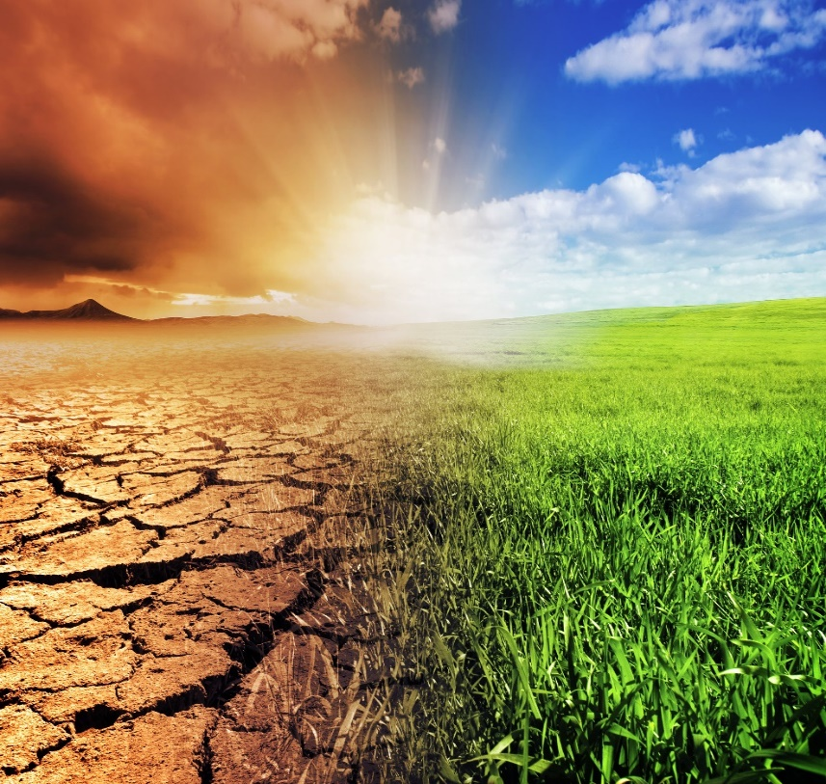
Background
Frontier Tech Leaders Programme Global Cohort 1
Climate change poses a significant threat to food security by affecting crop yields, water availability, and livestock productivity.
Addressing climate change is essential for ensuring food security and combating hunger. Conversely, improving food security can also mitigate the impacts of climate change by reducing greenhouse gas emissions associated with agriculture and food production.
Projects those address both SDG 13 and SDG 2 are critical for creating a more sustainable and equitable world.
Traditional climate models project future climate scenarios but often lack specific predictions on their effects on food security.
Systems exist for predicting weather patterns and natural disasters but may not link these predictions directly to food security outcomes.
Climate Change — As You Sow

Slide 5


Background
Frontier Tech Leaders Programme Global Cohort 1
Project importance:
Machine learning models can process and integrate large datasets, including climate data, agricultural productivity records, and hunger indices, to identify complex patterns and relationships.
Our project uses machine learning and deep learning to predict climate change impacts on food security.
Enhanced Predictive Accuracy: More precise forecasts of climate effects on agriculture for better planning and resource allocation.
WAITRO SDG2. 2023
Medium. 2018

Slide 6
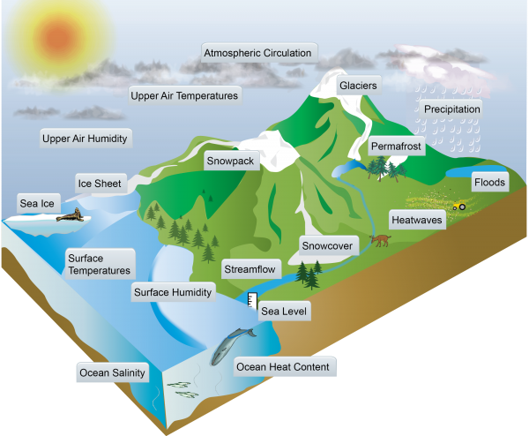

Objectives
Frontier Tech Leaders Programme Global Cohort 1
Project objectives:
Develop predictive models to estimate the impact of climate change on crop yields using historical climate and agricultural data.
Identify and analyze key climate variables that significantly affect food security.
Enhance understanding of regional vulnerabilities to climate change and suggest targeted interventions.
Geofao. 2013

Slide 7
SDG Relation
Frontier Tech Leaders Programme Global Cohort 1
Our project tackles the 2nd and 13th Sustainable Development Goals, concentrating on zero hunger and climate action.
By integrating these objectives, we seek to examine the impact of climate change on food security by predicting essential factors like crop yield, cereal production, and undernourishment, utilizing climatological data as inputs.

Slide 8
Data
Frontier Tech Leaders Programme Global Cohort 1

Slide 9
Data Collection
Frontier Tech Leaders Programme Global Cohort 1
Sources of the dataset:
1. The Humanitarian Data Exchange (humdata.org), where we sourced data concerning natural resources and climate data, among others.
2. The FAOSTAT database, from which we have obtained data pertaining to food security.

Slide 10
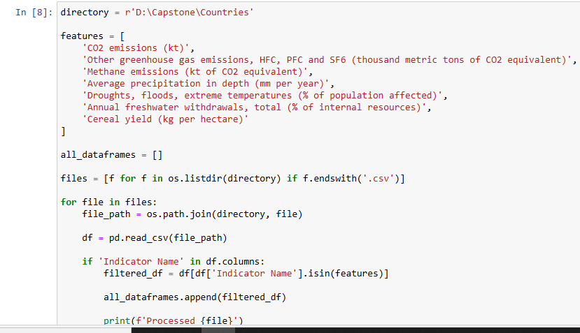
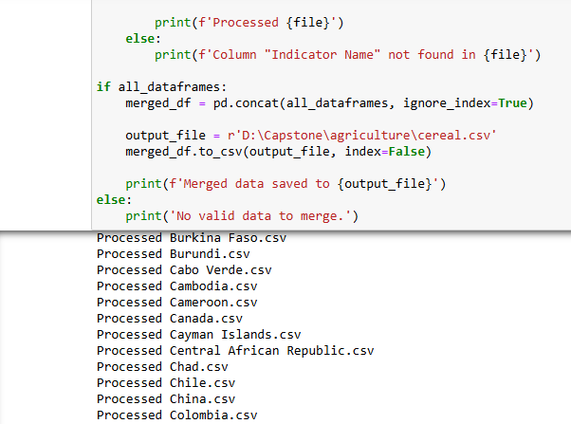
Data Collection
Frontier Tech Leaders Programme Global Cohort 1
Preprocessing steps during data collection
For The Humanitarian Data Exchange (humdata.org):-
Preprocessing during the data collection phase included cleaning, normalizing, and aggregating the data from different sources.
Datasets were downloaded in CSV format and prepared for feature engineering.

Slide 11
Cont.… Preprocessing steps during data collection
Setting Directory and Defining Features:
The script starts by defining a directory path (D:\Capstone\Countries) where the dataset files are stored.
A list of relevant features (indicators) is also provided, which include metrics like CO2 emissions, methane emissions, cereal yield, and more. These features are later used to filter the dataset.
Reading and Filtering Data:
Files Listing: All CSV files in the specified directory are listed and iterated over. Only files with the .csv extension are processed.
Reading CSV Files: For each CSV file, pd.read_csv() is used to load the data into a DataFrame.
Filtering by Indicator: The script checks if the file contains the Indicator Name column. If present, the DataFrame is filtered to retain only rows where Indicator Name matches one of the specified features. These filtered DataFrames are collected in a list (all_dataframes).
Concatenating Data:
Once all the files are processed, the script checks if any filtered DataFrames were collected. If so, the individual DataFrames are concatenated using pd.concat(), combining all the filtered data into a single DataFrame (merged_df).
Saving the Merged Data: The combined dataset is saved as a new CSV file (cereal.csv), allowing the processed data to be stored for future use.

Slide 12
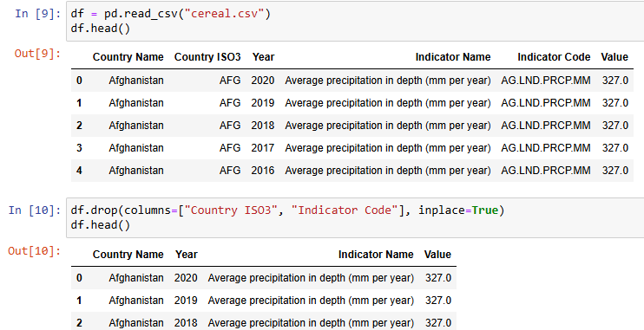
Cont.… Preprocessing steps during data collection
We then removed unnecessary columns, pivoted the data, and renamed columns for clarity. Finally, we saved the cleaned, reshaped, and renamed data to a new CSV file (cerealmixed2.csv), providing a dataset that is ready for analysis with clear column names and a structured format.

Slide 13
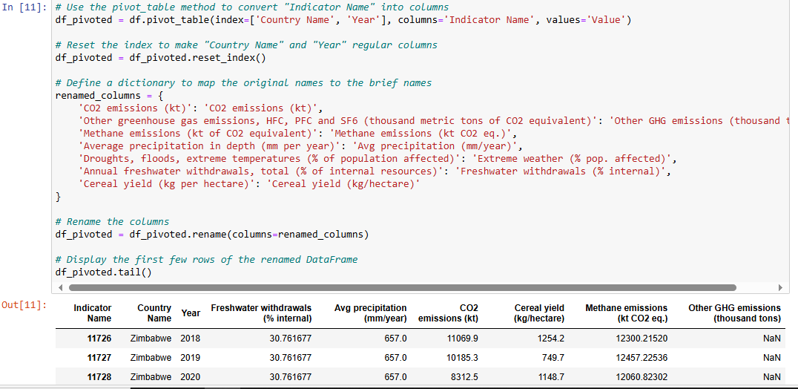
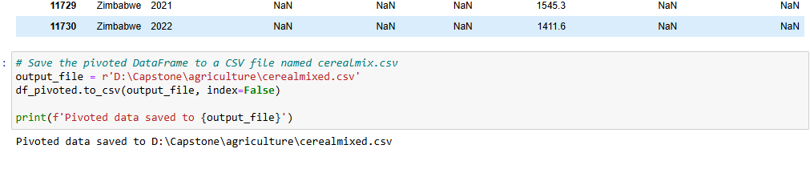
Cont.… Preprocessing steps during data collection

Slide 14
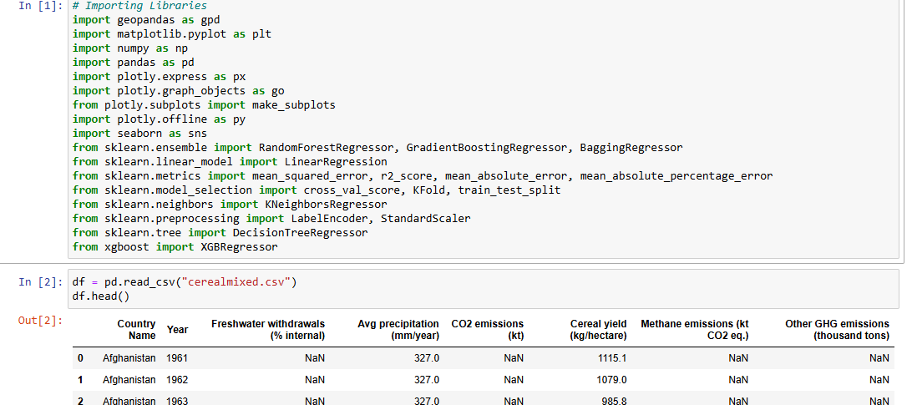
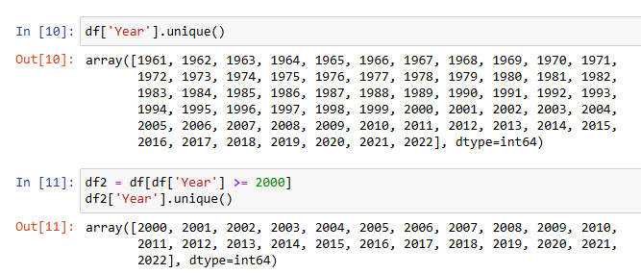
Data Collection
Frontier Tech Leaders Programme Global Cohort 1
Handling missing values
In order to fill missing values, fillna with different methods, such as mean, ffill, etc. were being used, and all that after making a copy of the original dataset with a variable we called df2 that contains just data for year >= 2000.

Slide 15
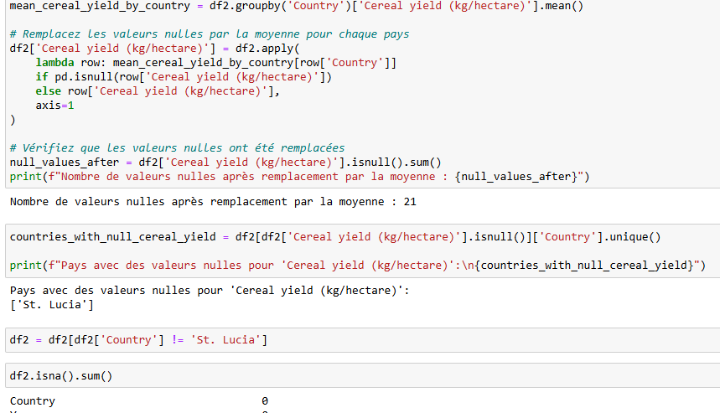
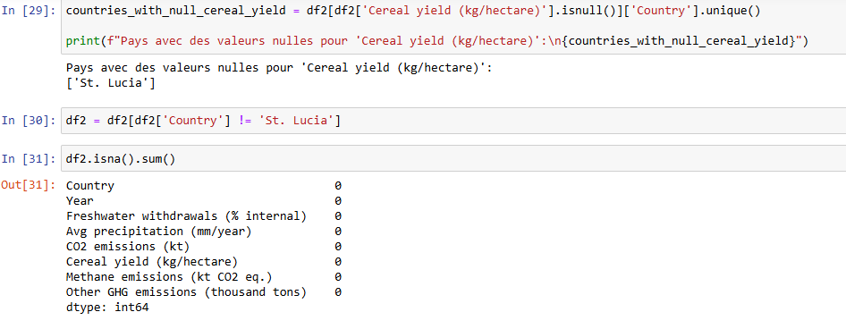
Cont.… Handling missing values

Slide 16
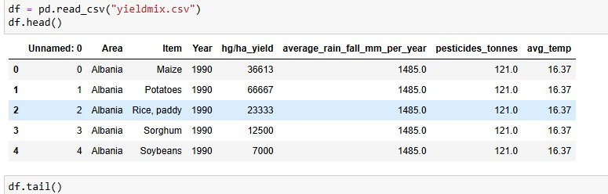
Exploratory Data Analysis (EDA) and Feature Engineering
Frontier Tech Leaders Programme Global Cohort 1
Process of creating or transforming features

Slide 17
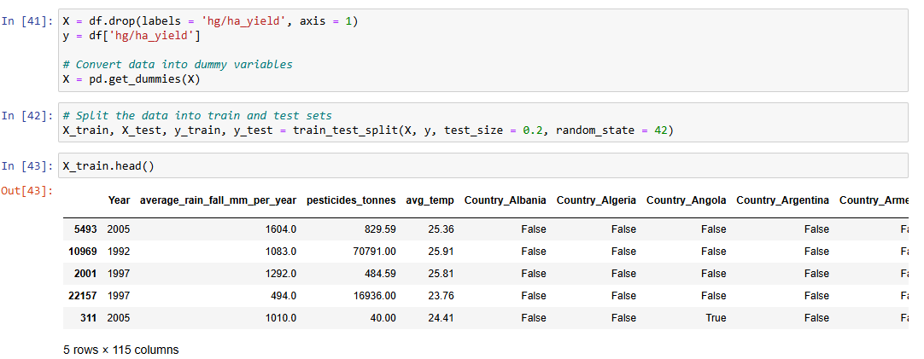
Cont.… Process of creating or transforming features
Frontier Tech Leaders Programme Global Cohort 1
The dataset contains categorical variables that are not in a numerical format, which machine learning algorithms cannot process directly. To transform these categorical variables, we applied one-hot encoding using pd.get_dummies().
This method converts each category into a new binary column (dummy variables), where a value of 1 indicates the presence of the category, and 0 indicates its absence.
The rationale behind this transformation is to represent the categorical data in a format suitable for models while avoiding assigning any ordinal relationship between the categories, which could lead to biased predictions.

Slide 18
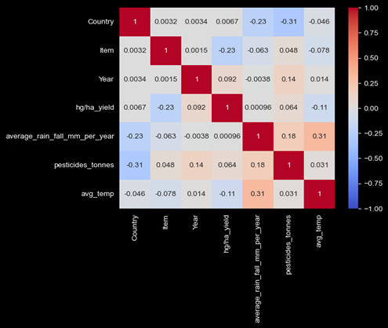
Cont.… Process of creating or transforming features

Slide 19
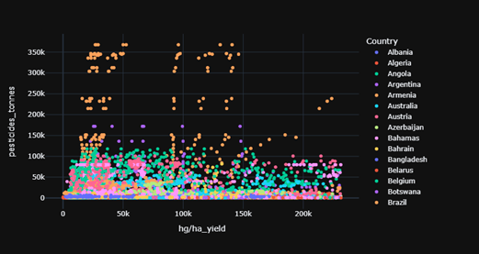
Cont.… Process of creating or transforming features

Slide 20
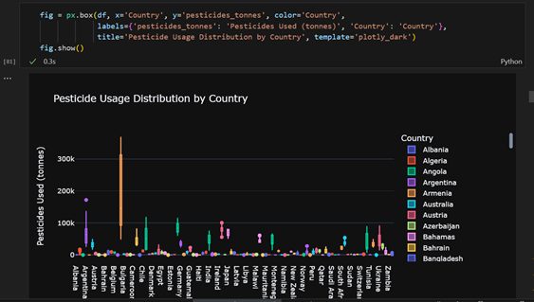
Cont.… Process of creating or transforming features

Slide 21
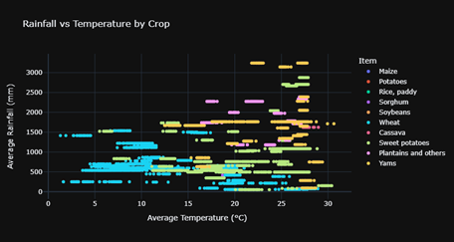
Cont.… Process of creating or transforming features

Slide 22
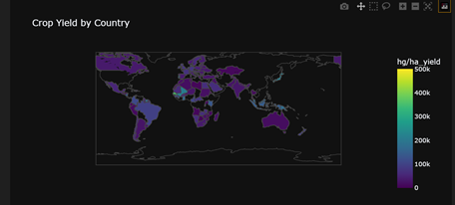
Cont.… Process of creating or transforming features

Slide 23
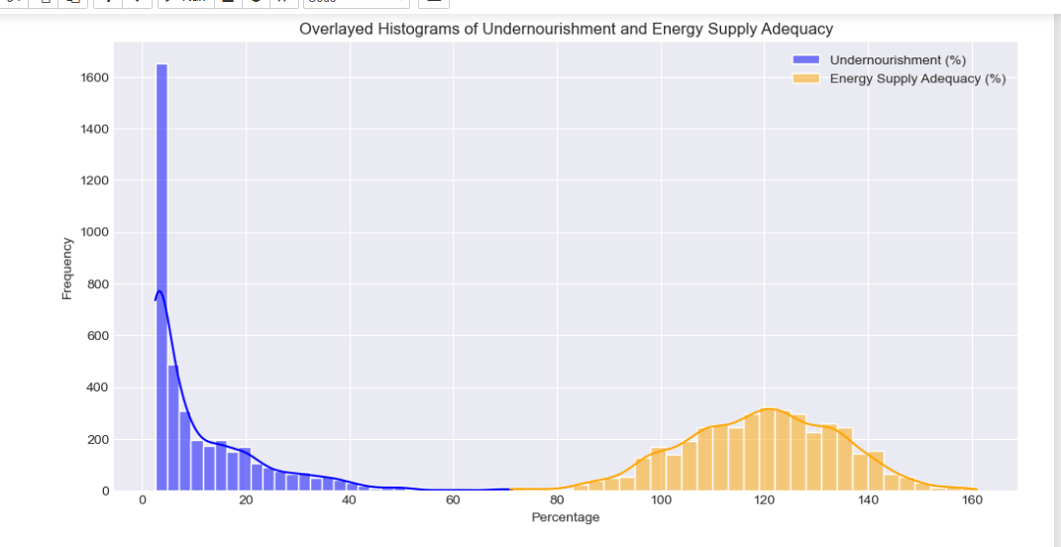
Cont.… Process of creating or transforming features

Slide 24
Model
Frontier Tech Leaders Programme Global Cohort 1

Slide 25
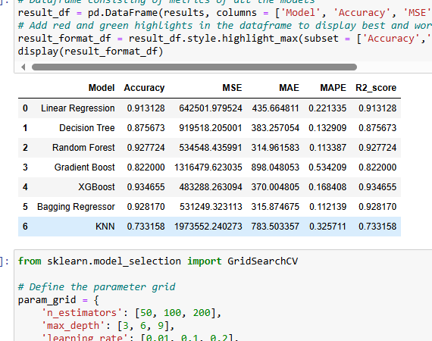
Predictions :
Model Selection and Training
We have made 3 different predictions, as follow:
1- We firstly predicted the cereal yield.
2- Secondly, we predicted the crop yield.
3- Lastly, we predicted the undernourishment.

Slide 26
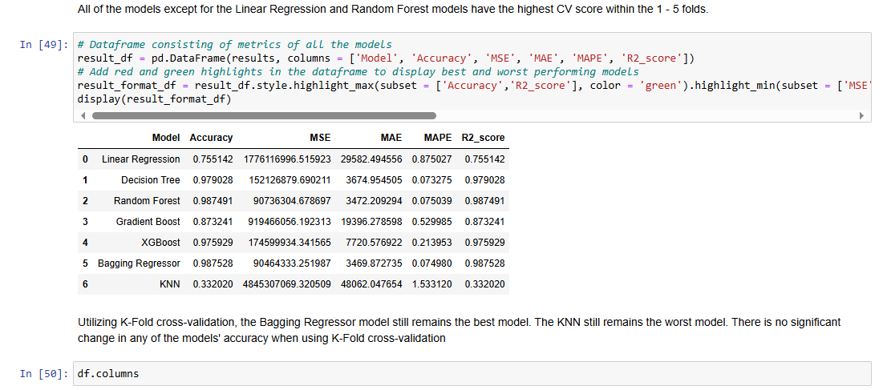
Cont… Predictions :

Slide 27
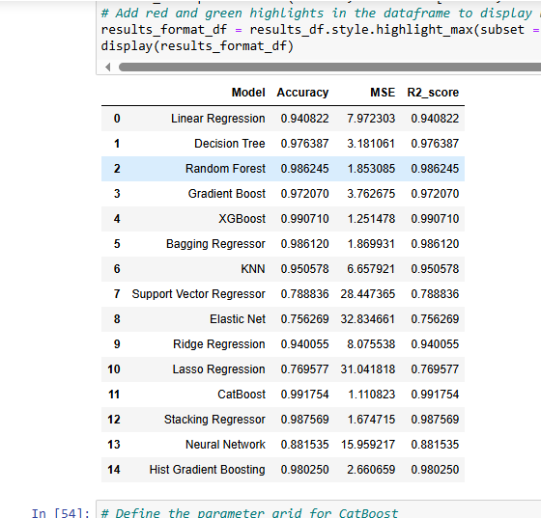
Cont… Predictions :
We have made 3 different predictions, as follow:
1- We firstly predicted the cereal yield.
2- Secondly, we predicted the crop yield.
3- Lastly, we predicted the undernourishment.

Slide 28
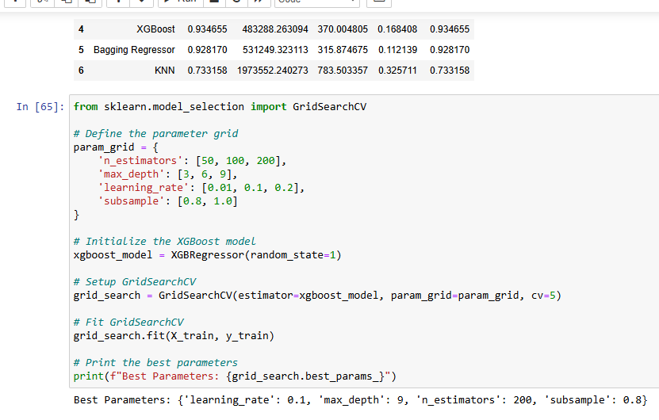
Model Evaluation and Hyperparameter Tuning
For the 3 predictions we used the GridsearchCV method to find the best parameters for each one of our 3 best models, as follow:

Slide 29
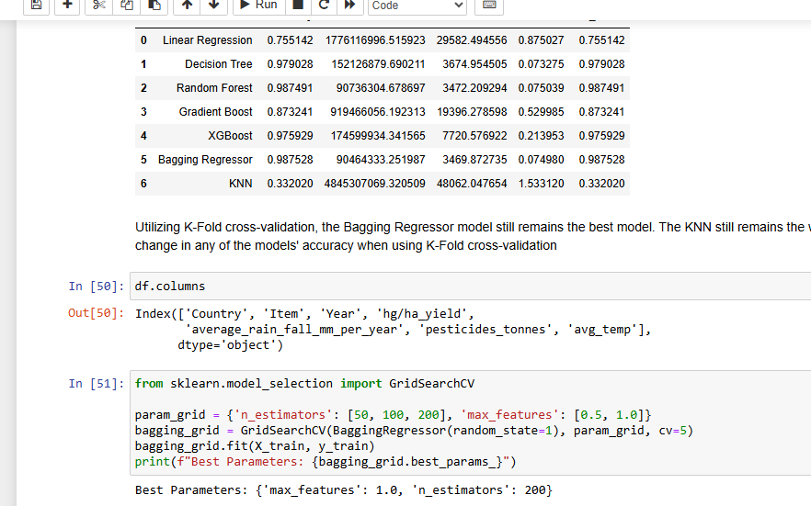
Model Evaluation and Hyperparameter Tuning

Slide 30
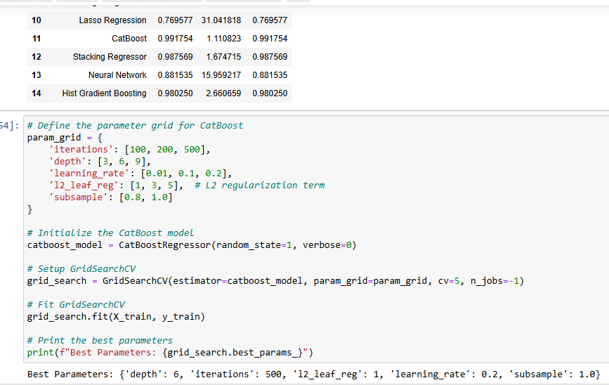
Model Evaluation and Hyperparameter Tuning

Slide 31
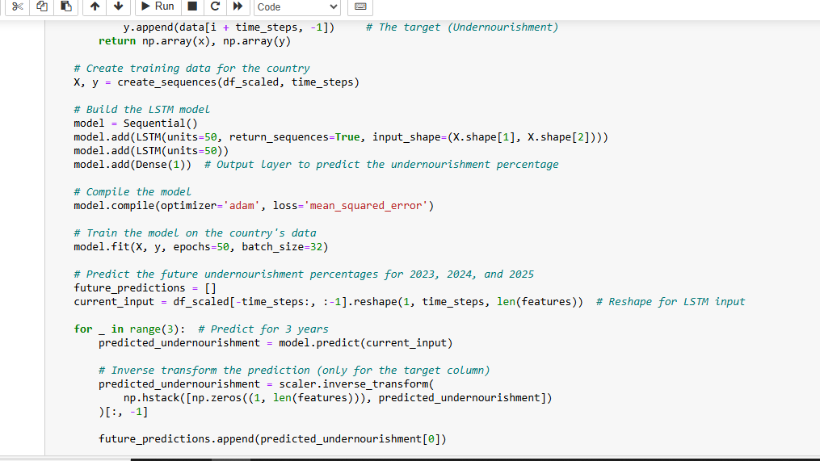
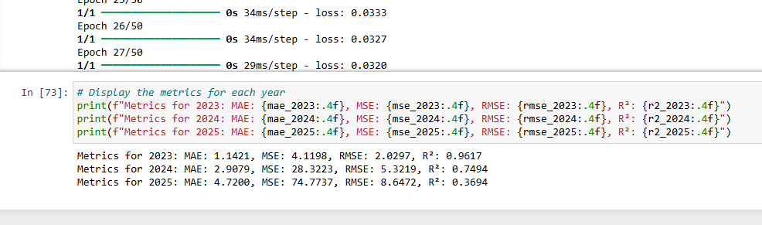
Model Evaluation and Hyperparameter Tuning

Slide 32
Results
Frontier Tech Leaders Programme Global Cohort 1

Slide 33
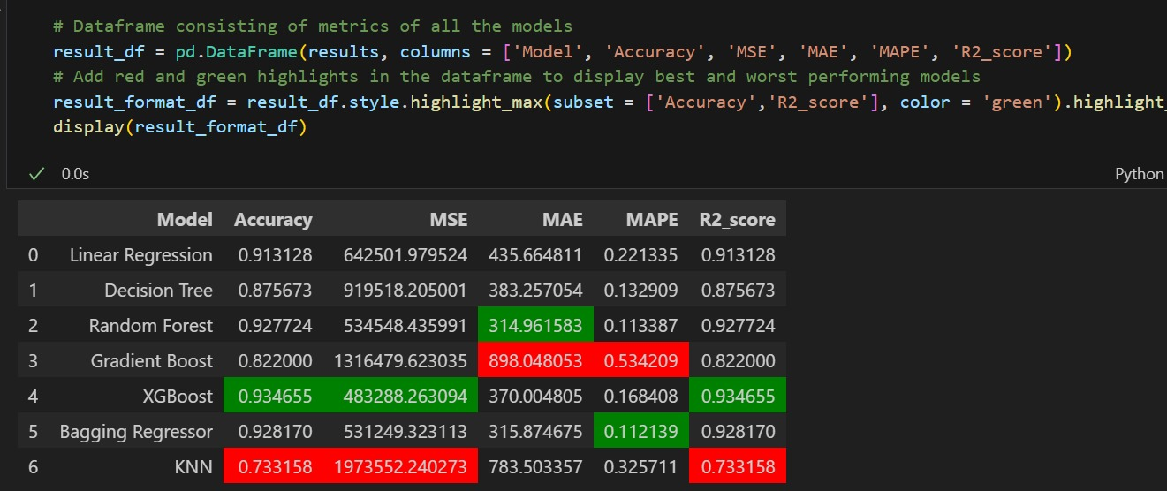
Evaluation Results
Frontier Tech Leaders Programme Global Cohort 1
Cereal yield

Slide 34
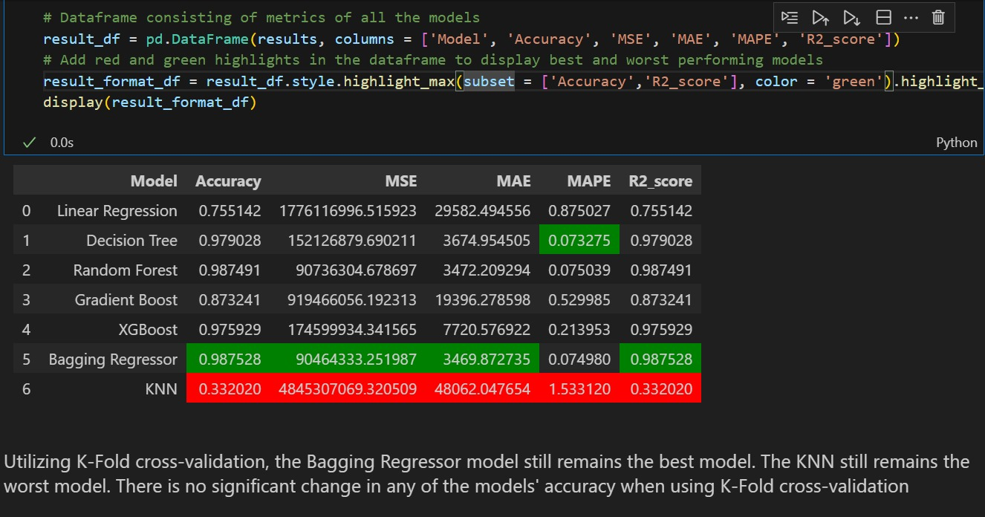
Evaluation Results
Frontier Tech Leaders Programme Global Cohort 1
Crop yield

Slide 35
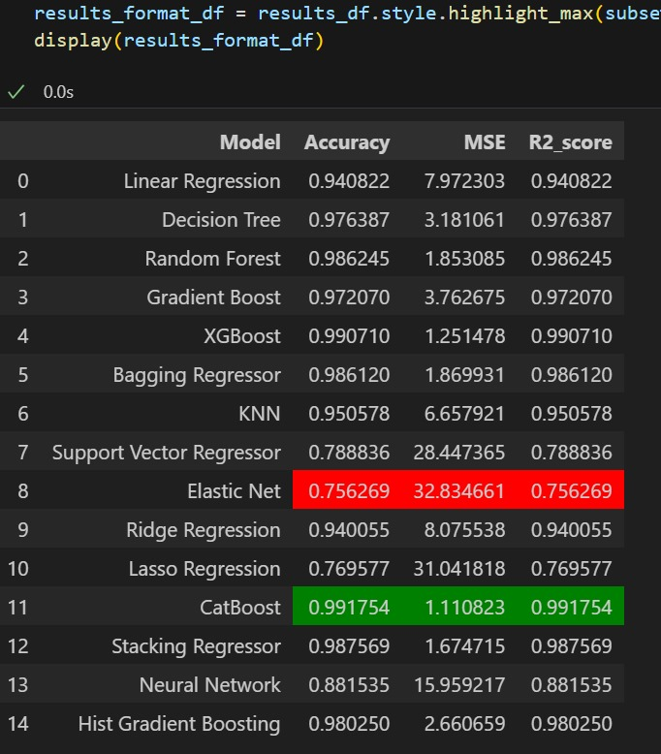
Evaluation Results
Frontier Tech Leaders Programme Global Cohort 1
Undernourishment

Slide 36
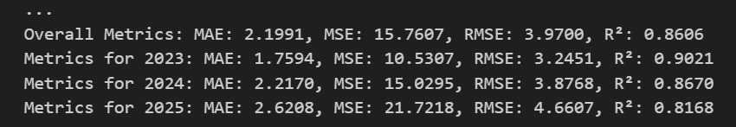
Evaluation Results
Frontier Tech Leaders Programme Global Cohort 1
Undernourishment Prediction using LSTM

Slide 37
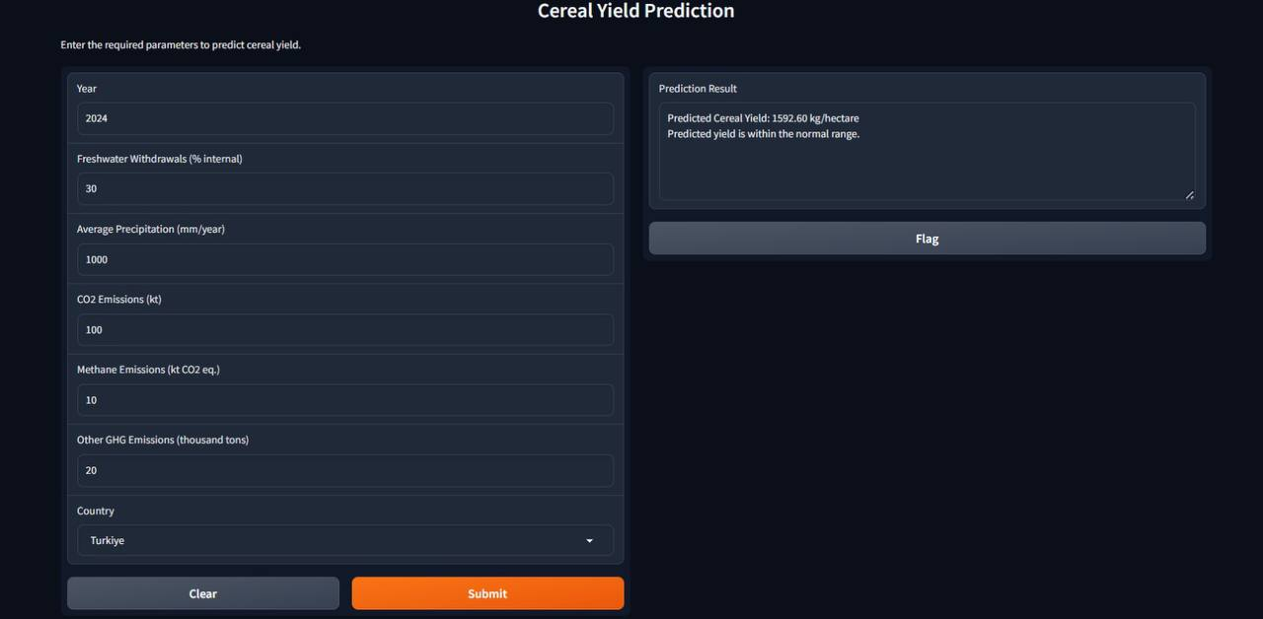
Deployment
Frontier Tech Leaders Programme Global Cohort 1
Local deployment with gradio

Slide 38
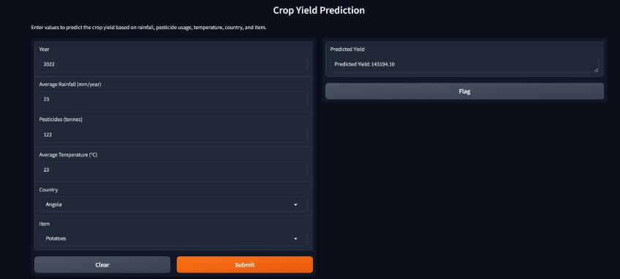
Deployment
Frontier Tech Leaders Programme Global Cohort 1
Local deployment with gradio

Slide 39
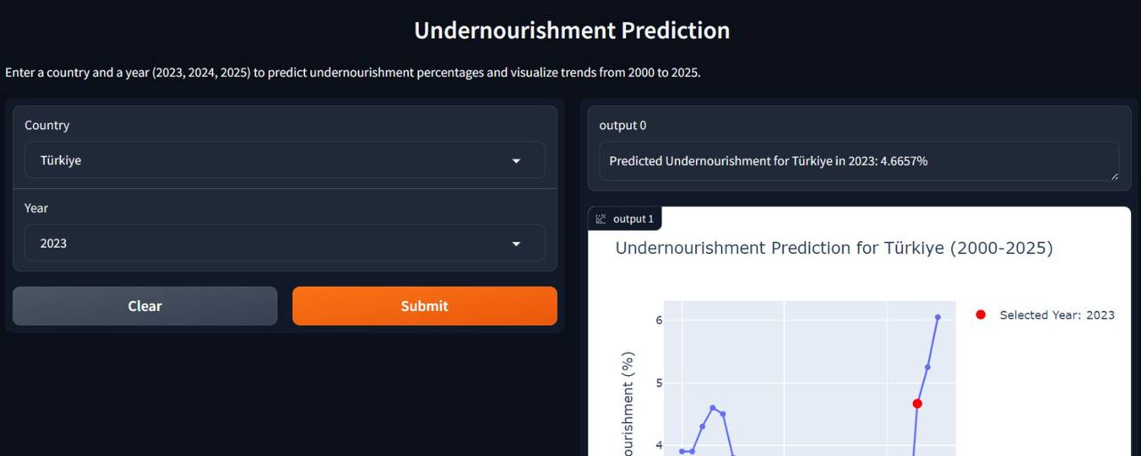
Frontier Tech Leaders Programme Global Cohort 1
Deployment
Local deployment with gradio

Slide 40
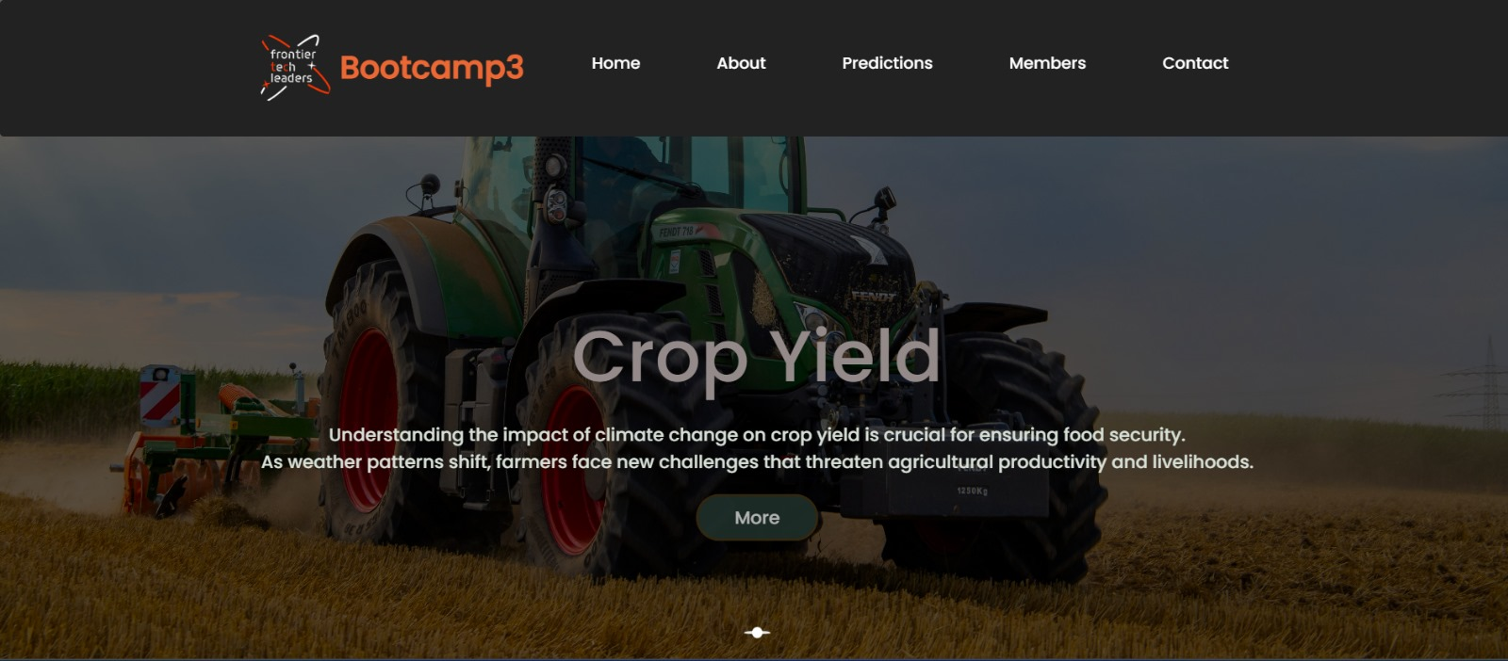

Deployment
Frontier Tech Leaders Programme Global Cohort 1
Project’s website

Slide 41
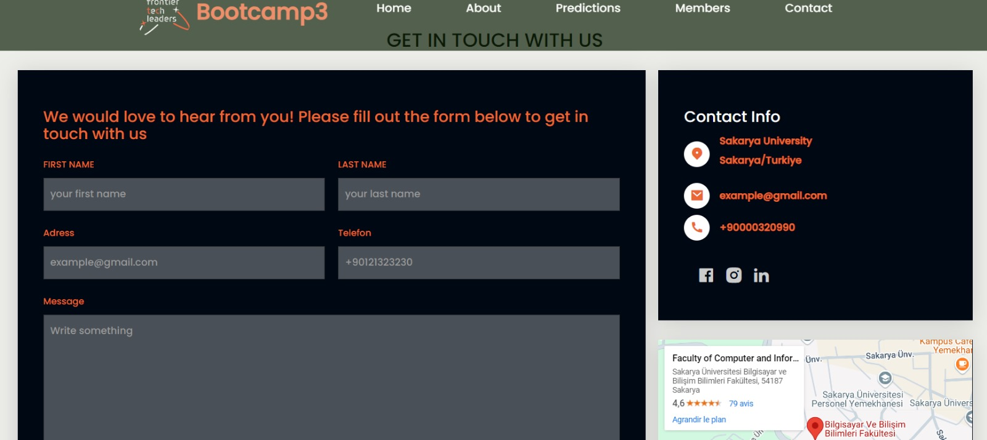
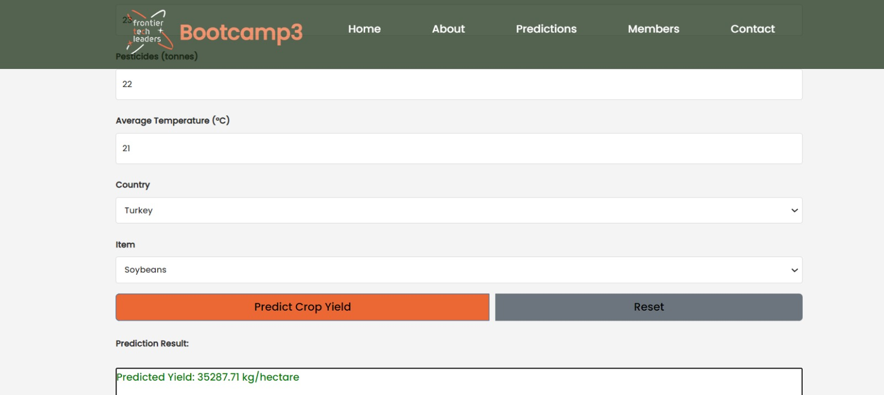

Deployment
Frontier Tech Leaders Programme Global Cohort 1
Project’s website

Slide 42


Deployment
Frontier Tech Leaders Programme Global Cohort 1
Project’s website

Slide 43
Future Work
Frontier Tech Leaders Programme Global Cohort 1
Develop models predicting crop yield impacts under different climate scenarios.
Create decision support systems for farmers based on ML analysis of local conditions.
Study the Global Hunger Index (GHI): Examine the relationship between key climate variables and the Global Hunger Index to understand their combined effect on global hunger levels.

Slide 44
References
Frontier Tech Leaders Programme Global Cohort 1
Climate Change — As You Sow. (n.d.). Retrieved September 25, 2024, from https://www.asyousow.org/our-work/climate-and-energy/climate-change
Parry ML, Rosenzweig C, Iglesias A, Livermore M, Fischer G. Effects of climate change on global food production under SRES emissions and socio-economic scenarios. Global Environ Chang. 2004;14(1):53–67.
Khan F, Khan F, Liou YA, Khan F, Spöck G, Wang X, et al. Assessing the impacts of temperature extremes on agriculture yield and projecting future extremes using machine learning and deep learning approaches with CMIP6 data. Int J Appl Earth Obs Geoinf. 2024;132(300).
Xiong R, Peng H, Chen X, Shuai C. Machine learning-enhanced evaluation of food security across 169 economies. Environ Dev Sustain [Internet]. 2024;(0123456789). Available from: https://doi.org/10.1007/s10668-024-05212-1
Tubiello FN. System of Environmental-Economic Accounting for Agriculture, Forestry and Fisheries
Food Security Indicators [Presentation]. 2016;(June):24–6. Available from: https://seea.un.org/sites/seea.un.org/files/food_security_indicators.pdf
WAITRO SDG2 Workgroup Webinar- Harvesting Global Solutions: Uniting for Zero Hunger Research Collaborations and Funding Opportunities - WAITRO. (n.d.). Retrieved October 1, 2024, from https://waitro.org/event/waitro-sdg2-workgroup-webinar-harvesting-global-solutions-uniting-for-zero-hunger-research-collaborations-and-funding-opportunities/
Artificial Intelligence and Global Challenges — Zero Hunger | by DAIA | DAIA | Medium. (n.d.). Retrieved October 1, 2024, from https://medium.com/daia/artificial-intelligence-and-global-challenges-a-plan-for-progress-603efece1905
Climate Change • Integrated Water Resource Management - from traditional knowledge to modern techniques • Department of Earth Sciences. (n.d.). Retrieved October 1, 2024, from https://www.geo.fu-berlin.de/en/v/iwrm/Implementation/water_and_the_physical_environment/Climate-and-Climate-Change/climate_change/index.html

Slide 45


Thank you!
Frontier Tech Leaders Programme Global Cohort 1

